Slide 1

Object Detection using YOLOV3
Sai Shilpa Padmanabula – spadmanabul@leomail.tamuc.edu

Slide 2
Outline
We are going to discuss about how the object detection works.
Different algorithms that work for Object detection.
As we choose YOLOV3, we are going to learn about that algorithm.
How this algorithm works?
We are going to discuss about dataset and the required files and tools
Final results of the project.
Future work and references.

Slide 3
Outline (Example)
Introduction/Background
Project Objectives
Data Collection
Methods
Results and screenshots of the project
Observations and discussions
Summary
References

Slide 4
Introduction/Background
Object detection is one of the pivotal and main demanding problems in computer vision.
It’s one among the areas of computer vision that is maturing very rapidly.
Human glances at an image and detects what objects are, where they are, how they interact.
Human visual system is very fast and accurate.
Similarly, we are going to use this intelligence on computers by building fast and accurate algorithms.
Regression problem : separate bounding box, associate class probabilities.
Whole detection pipeline is a single network which predicts bounding boxes and class probabilities.
Extremely fast.
Process image at 45 FPS

Slide 5
Contd..
We have various algorithms for object detection but for this project we use YOLO (You Only Look Once).
YOLO forwards the whole image only once through a deep learning network whereas it requires multiple scans for other algorithms.
Whole detection pipeline is a single network which predicts bounding boxes and class probabilities.
Extremely fast and Processes image at 45 FPS.
Objects are detected from images & videos.

Slide 6
Contd..
Object recognition is habitually a superset of object detection
Object recognition means acknowledging objects in images and videos.
Object Recognition technique can often be persistently referred to as Image Recognition.
Object recognition consists of identifying, recognizing, and locating objects within a picture.
The images will be assigned class labels throughout the image classification process.

Slide 7
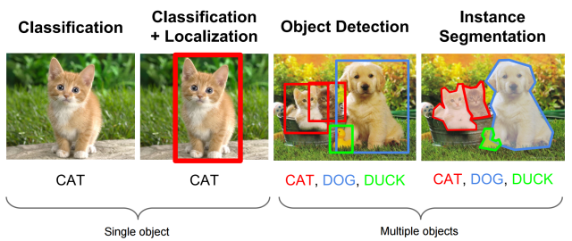
contd..
Pictorial representation of object recognition task

Slide 8
Contd..
Object Localization pinpoints to seek out the location of the single object inside the image.
Object detection is the result of combining object localization and image classification.
Object detection is tougher and fuses these two tasks and draws a bounding box around each object of interest in the image and assigns them a class label.
In “Object Instance Segmentation”, the instances of identified objects are stipulated by highlighting the certain pixels of the object instead of a coarse bounding box.

Slide 9
YOLOV3
YOLOv3 contains Darknet-53 architecture.
It has fifty-three convolutional layers and is trained on the ImageNet dataset.
This model is powerful to spot even tiny objects from the image.
YOLOV3 can be able to recognize quite eighty varied objects in one image.
For the task of detection, fifty-three additional layers are stacked onto it, giving us a 106 layer fully convolutional underlying design for YOLOV3.

Slide 10
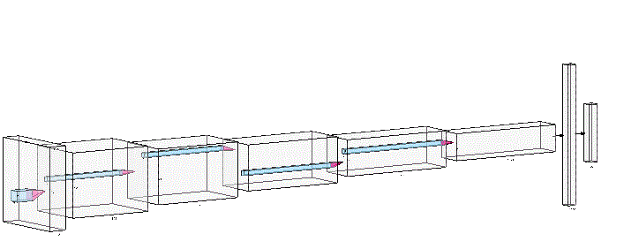
Contd…
Architecture of YOLOV3

Slide 11
Contd…
In YOLOv3, every class score is predicted using logistic regression and a threshold is employed to predict multiple labels for an object.
Classes with scored higher than this threshold are appointed to the box.
The activation function we use to calculate the scores is 1/ (1+e-x) often referred as sigmoid function.
After detecting the pictures using YOLOv3 we obtain the bounding boxes of the detected object and a class label assigned to it with a confidence score.

Slide 12
Project Objectives
Our main objective is to detect the objects from both image and video.
Localizing the object and assigning a label to it with the confidence score.
Bounding box around the detected object.
Detection of as many objects in the image and video.

Slide 13
Data Collection
We have used COCO (Common Objects in Context) dataset.
COCO is a massive scale object detection, person key point’s detection, and segmentation dataset. COCO has several features:
COCO has 91 classes but data uses only 80 classes.
This dataset gathers the complex images of everyday scenes which contains common objects in their natural context.
To get the precise localization of objects
1.5 million Object instances.

Slide 14
Contd…
Here we introduce a new large-scale dataset which addresses three core problems of research in scene understanding. They are:-
Detecting non-iconic views of objects
Contextual reasoning between objects
Precise 2D localization of objects

Slide 15
Methods
To detect the objects initially we need to download three files:
1. Yolo.cfg — Configuration file
2. Yolo. Weights — pre-trained weights (This file is pre-trained on ImageNet dataset in which it contains 1000 classes).
3. Coco. Names dataset - 80 classes names
Both configuration files and weight files are needed to make predictions.

Slide 16
Method to detect objects from image
Firstly, we imported all the libraries.
We will load the COCO dataset and skim all the classes, performs strip and split operation so that finally we get the 80 classes within the sort of list.
Then we load yolov3 algorithm by using the cv2.dnn.readNet by passing all the weights and cfg file.
From the loaded yolov3 model we extracted all the layer names using getLayerNames () method. It gives the output as a list of 254 layers.

Slide 17
Contd..
The forward function within the openCV’s net class demands the ending layer till which it should run the network.
Since we would like to run through whole network, we need to identify the last layers of the network. We do this by using the method getUnconnectedOutLayers ().
Now we will read an image and extract the image width and height using image. Shape () method.
Finally, we sent the model, image, image height, image width, layer names, and class names in to detect object function for detecting the objects.

Slide 18
Contd..
So, to properly predict the object with deep neural networks, we need to pre-process our data and “Cv2.dnn” module provides us blobFromImagefunction.
This function perform scaling, mean subtraction and channel swap.
After the pre-processing we get the output which is our input image to the model.
The forward() function of cv2.dnn module returns a nested list containing information about all the detected objects which includes the x and y coordinates of the center of the object detected, height and width of the

Slide 19
Contd..
bounding box, confidence and scores for all the classes of objects listed in coco. Names.
Now we discover the list of bounding boxes.
There could be cases that multiple time an equivalent object could be detected. We would like to eliminate this.
To eliminate this, we are going to use Non-Max Suppression (NMS) cv.dnn.NMSBoxes () functionality.
What this could do is eliminate the boxes by using some threshold value (any box having value less than 0.6- which will be removed) and it determines that keep solely the simplest of all boxes.

Slide 20
Contd…
Indexes variable can keep track of such distinctive objects detected. Thus, there will be no multiple detection of the similar objects.
Finally, we write a function to label the bounding boxes with rectangle shape, color it, and put text which contains class name on it with its confidence value.

Slide 21
Method to detect objects from video
A video may be a sequence of fast paced images .
FPS which can also be called as Frames per Second is a metric which is employed to detect how briskly the pictures are moving.
If we are saying that the video contains FPS of 40, then it means 40 images are being displayed at every second and for each 25 milliseconds a replacement frame is being displayed.
So, to detect the objects from the video we described a process below.

Slide 22
contd..
Similar process is followed to detect objects in video same as image until the identification of the last layers of the network by using the method getUnconnectedOutLayers ().
In OpenCV, a video can be read by reading a video file.
The initiative towards reading a video is to make a video capture object. Its argument are often either the device index or the name of the file to be read.
Create a video capture object and skim from the input data.

Slide 23
Contd..
After the video capture object is made, we will capture the video frame by frame.
Now extract the properties of frame like frame_width and frame height.
Send the frames, layer names, class labels, frame properties and therefore the loaded cnn model to a function which detects the objects.
The function performs pre-processing and detected objects are sent to a different function to draw the bounding boxes round the detected objects from the frames.

Slide 24
contd..
The output of the bounding boxes are returned in order that for every new detected object a replacement frame is made to make new video. For this purpose, video writer is employed.
We got to specify a FourCC (Four Character Code) which may be a 4-byte code to specify the video codec.
Using Cv2.VideoWriter, we can create a replacement video which contains all the new frames of detected objects.
Finally, the new video is generated.

Slide 25
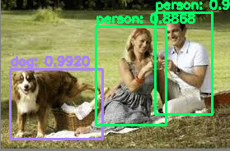
Results and screenshots of the project
The output of our project for the image is shown below.
Output screenshot for image

Slide 26
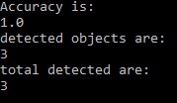
contd…
The accuracy regarding the above output is shown below.

Slide 27
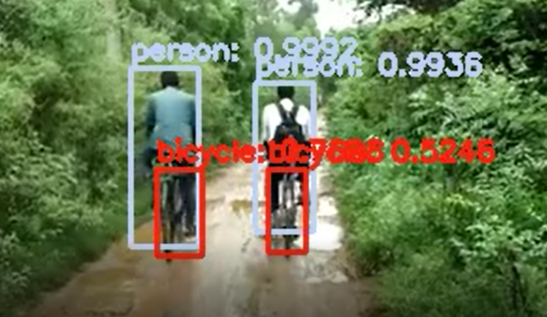
Contd..
The output of our project for the video is shown below.

Slide 28
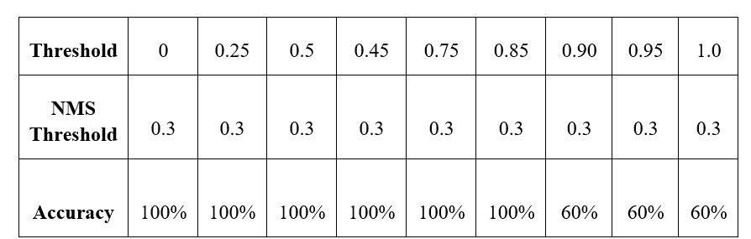
Observations and discussions
For this project we have two thresholds. Normal threshold value and NMS threshold value.
We have tested the accuracy by changing the threshold value and kept the NMS threshold value constant.

Slide 29
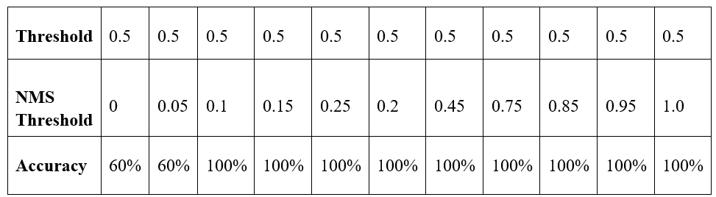
Contd…
Now we have tested the accuracy by keeping threshold value constant and by changing the NMS Threshold value. The results are shown below
Now we will find accuracy by changing both NMS threshold and Threshold value. The results are shown below.

Slide 30
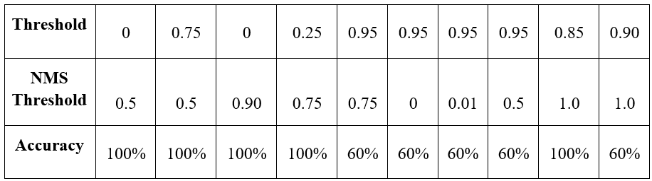
Contd…
According to our observations when Threshold value is 0.5 and when NMS Threshold value is > 0.2 then will get the better accuracy. These observations are also identified by the authors[4].

Slide 31
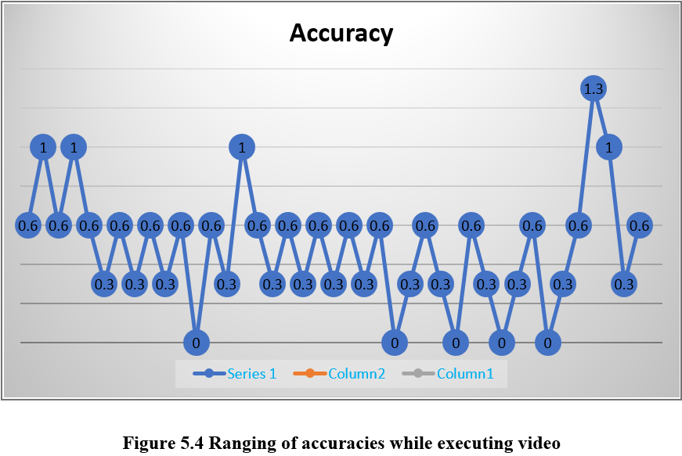
Contd..
While executing the video, we employed the accuracy of each frame such that it calculates the accuracy for each detected objects in each frame.
We showed the recorded accuracies through a graph and it is shown below.

Slide 32
Can We Improve?
In future we intend to develop this into a real time application which will be useful in many ways.
Real time application is an application program that functions within the time frame given by the user as on-the-spot.
There are many applications like self-driving cars, tracking objects[1], face detection, pedestrian detection, medical imaging, robotics etc.
The advantage of real time application is that we don’t need any man force to do all the tasks.

Slide 33
Summary
We instigate YOLO, which is a unified model for object detection. Our model is to construct and can be trained through on full images.
We have different approaches for object detection like R-CNN, fast R-CNN, faster R-CNN, YOLO (You only look once) and SSD (Single shot detector).
When compared to R-CNN, fast R-CNN is quick but it uses selective search which slows down the method.
Faster R-CNN uses the convolutional network called regional proposed network instead of selective search which makes it almost 10 times faster than fast R-CNN.
However, choosing the correct approach for object detection is based on the problem we are solving.

Slide 34
Contd..
If only speed is considered, neglecting the accuracy we use YOLO and for computation problems SSD is better choice.
Contrasting to classifier-based approaches, YOLO is trained on a loss function which solely concentrates on the detection performance and therefore the whole model is trained conjointly.
YOLO is the quickest and commonly used object detector within the literature.
Moreover, YOLO generalizes well into the new domains by creating an ideal for the application that considers quick, sturdy object detection.

Slide 35
References
[1] S. Shakil, A. Rajjak, and A. K. Kureshi, “Object Detection and Tracking using YOLO v3 Framework for Increased Resolution Video,” no. 6, pp. 118–125, 2020, doi: 10.35940/ijitee.E3038.049620. (E3038039520 - International Journal of Innovative Technology and Exploring Engineering (IJITEE))
[2] J. Redmon, S. Divvala, R. Girshick, and A. Farhadi, “You Only Look Once: Unified, Real-Time Object Detection.” ([1506.02640] You Only Look Once: Unified, Real-Time Object Detection (arxiv.org))
[3] J. Redmon and A. Farhadi, “YOLO9000: Better, faster, stronger,” Proc. - 30th IEEE Conf. Comput. Vis. Pattern Recognition, CVPR 2017, vol. 2017-Janua, pp. 6517–6525, 2017, doi: 10.1109/CVPR.2017.690. (YOLO9000: Better, Faster, Stronger | IEEE Conference Publication | IEEE Xplore)

Slide 36
contd..
[4] J. Redmon and A. Farhadi, “YOLOv3: An Incremental Improvement,” 2018, [Online]. Available: http://arxiv.org/abs/1804.02767. ([1804.02767] YOLOv3: An Incremental Improvement (arxiv.org))
[5] A. Vidyavani, K. Dheeraj, M. Rama Mohan Reddy, and K. N. Kumar, “Object detection method based on YOLOv3 using deep learning networks,” Int. J. Innov. Technol. Explor. Eng., vol. 9, no. 1, pp. 1414–1417, 2019, doi: 10.35940/ijitee.A4121.119119. (A4121119119 - International Journal of Innovative Technology and Exploring Engineering (IJITEE))

